Slide 1
National Scholarships Portal 2.0
Detailed guide/work flow for registration of students in the different Scholarship Schemes

Slide 2
NSP HOME PAGE

Slide 3
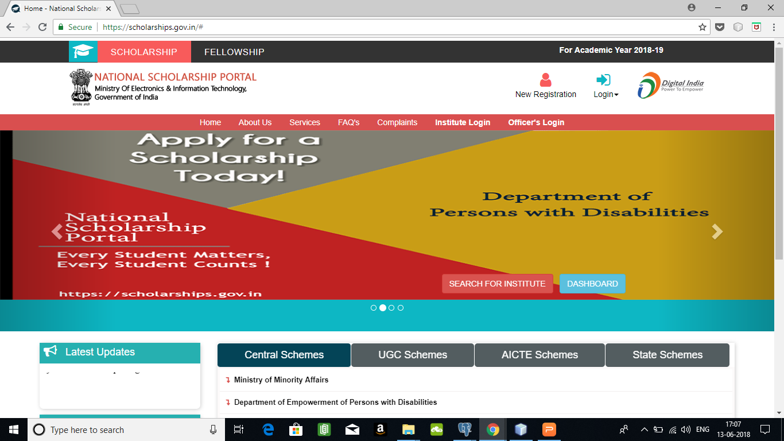
for new user click on New Registration

Slide 4
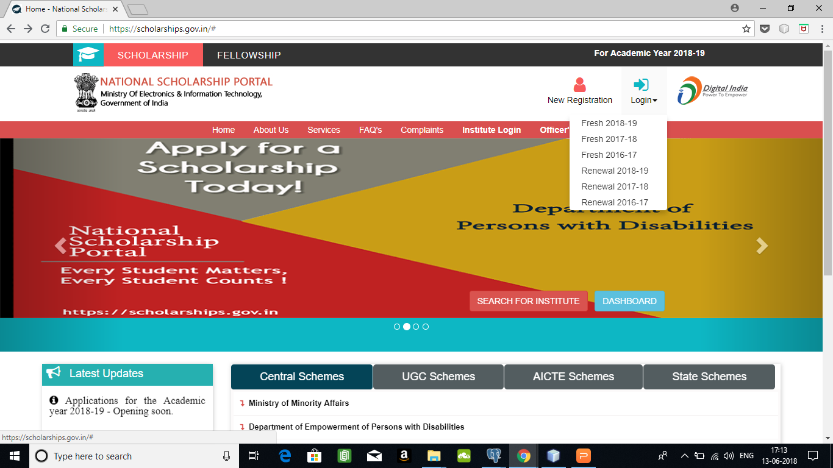
For existing user click on Login

Slide 5
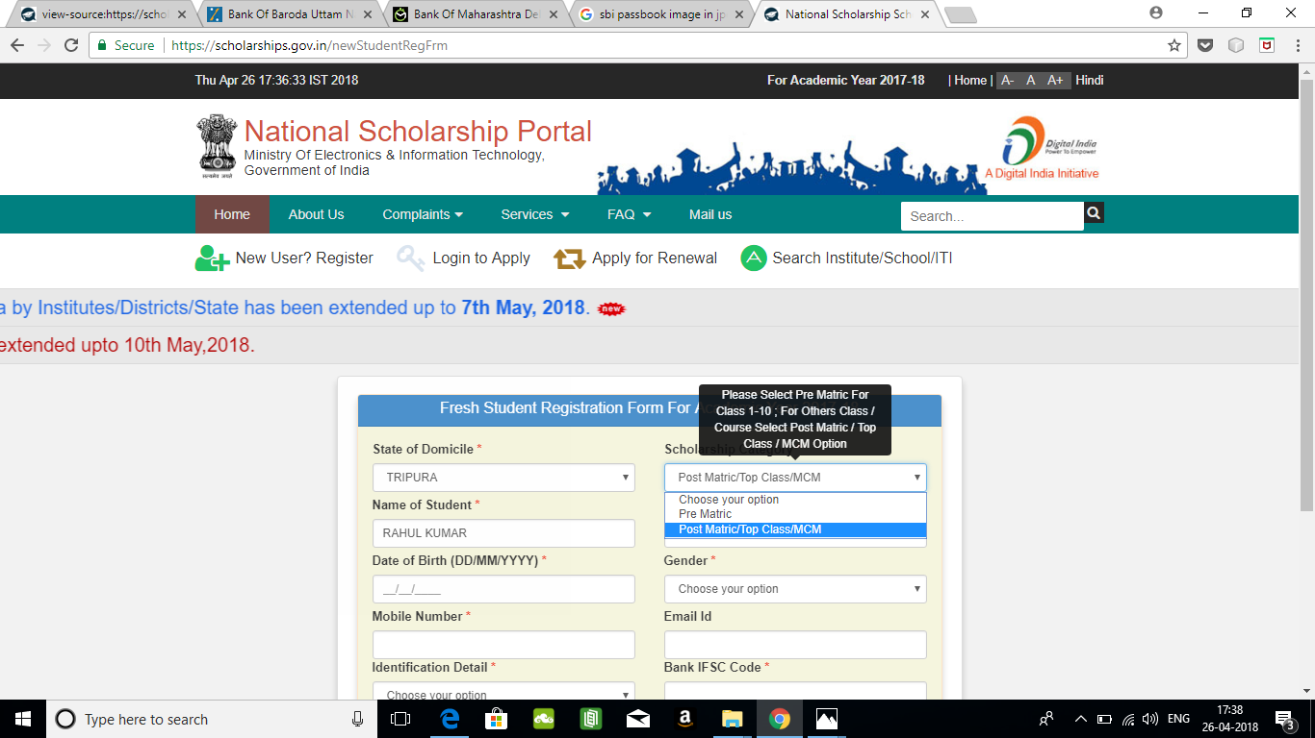
Fresh Student Registrtion Form
On Clicking on “New Registration, a new registration form opens
Select Pre-Matric for class 1-10
Select Post Matric/MCM/TOPCLASS for Class 11,12,UG,PG etc

Slide 6
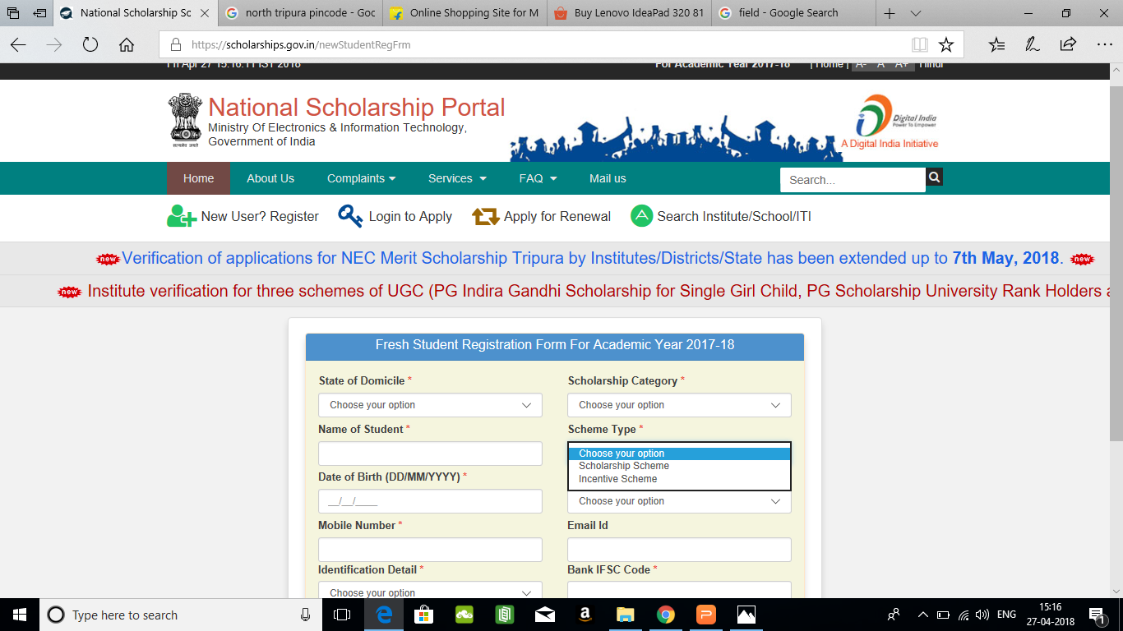
Select Scholarship scheme if you want to apply for Scholarships.
Select Incentive Scheme if you want to apply for any incentive scheme

Slide 7
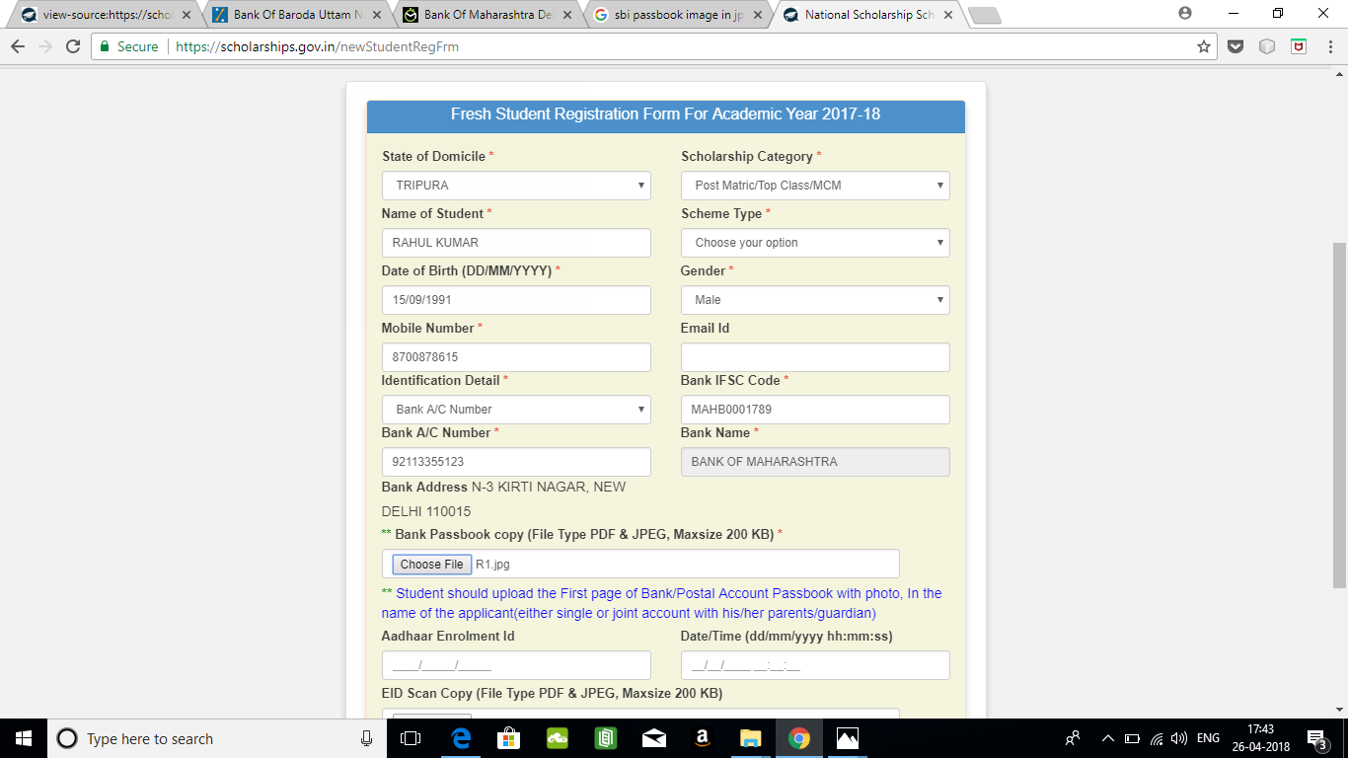
Fields marked with a red star are Mandatory to fill
You can select to give your bank details or your aadhaar details as your identification
Upload your Bank Passbook copy in PDF or Jpeg Format. Maximum size 200KB

Slide 8
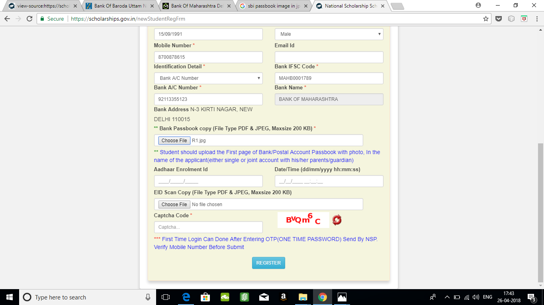
Enter the captcha given on the right side
After filling the form, click on Register to get an unique application number on your registered mobile phone number

Slide 9
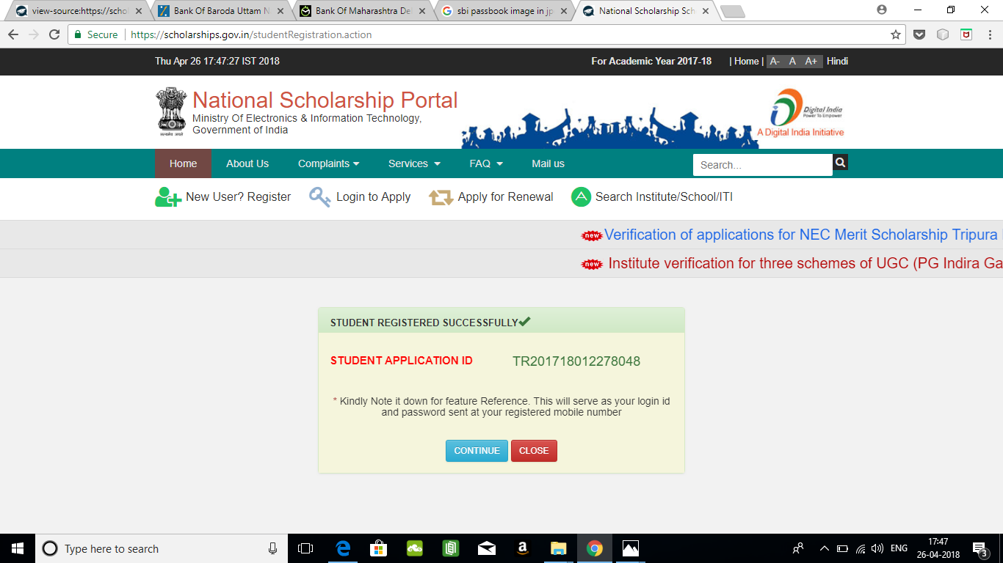
On Clicking “Register”, you will get a unique application number and password as SMS in the registered mobile number. Click on Continue to continue to login for Application

Slide 10
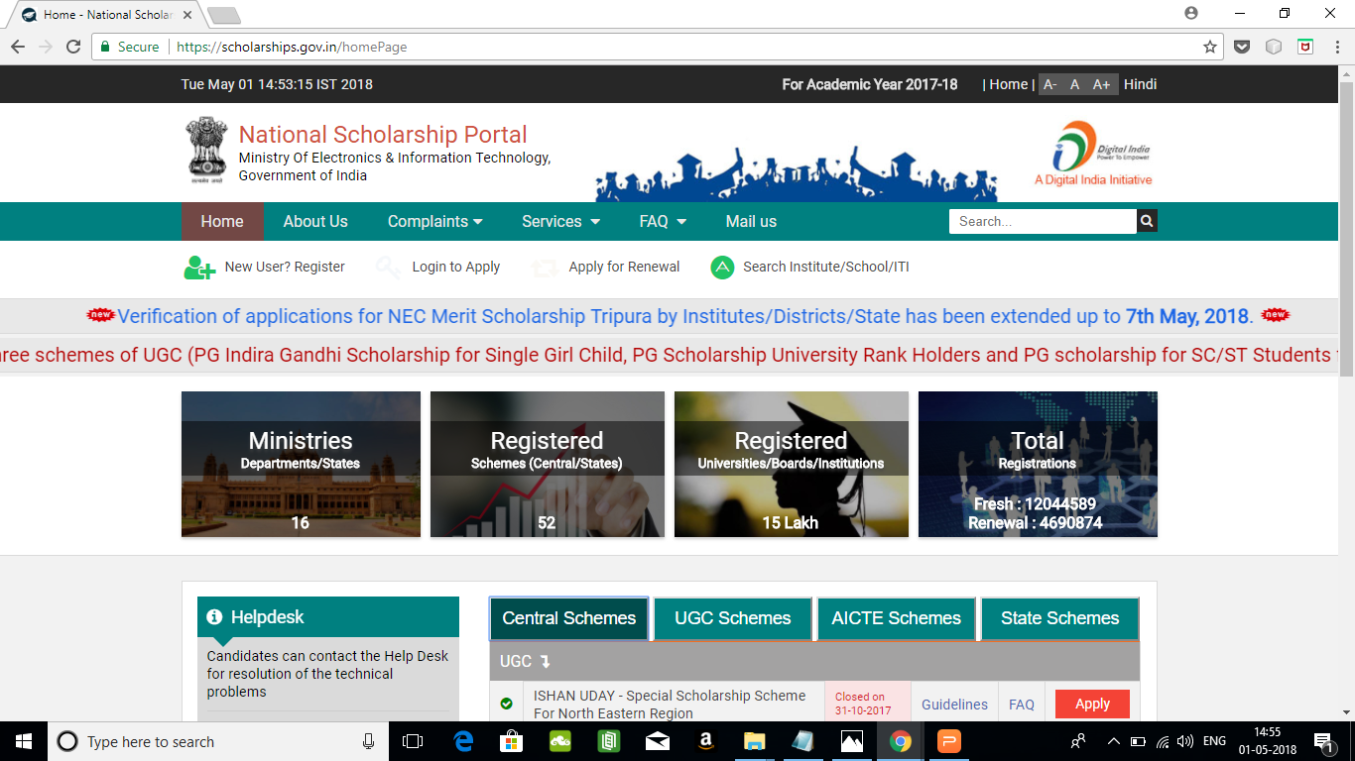
LOGIN FOR FRESH APPLICATION
After getting the Application id, you can go to the home page and click on “Login to Apply “ for the detailed application form

Slide 11
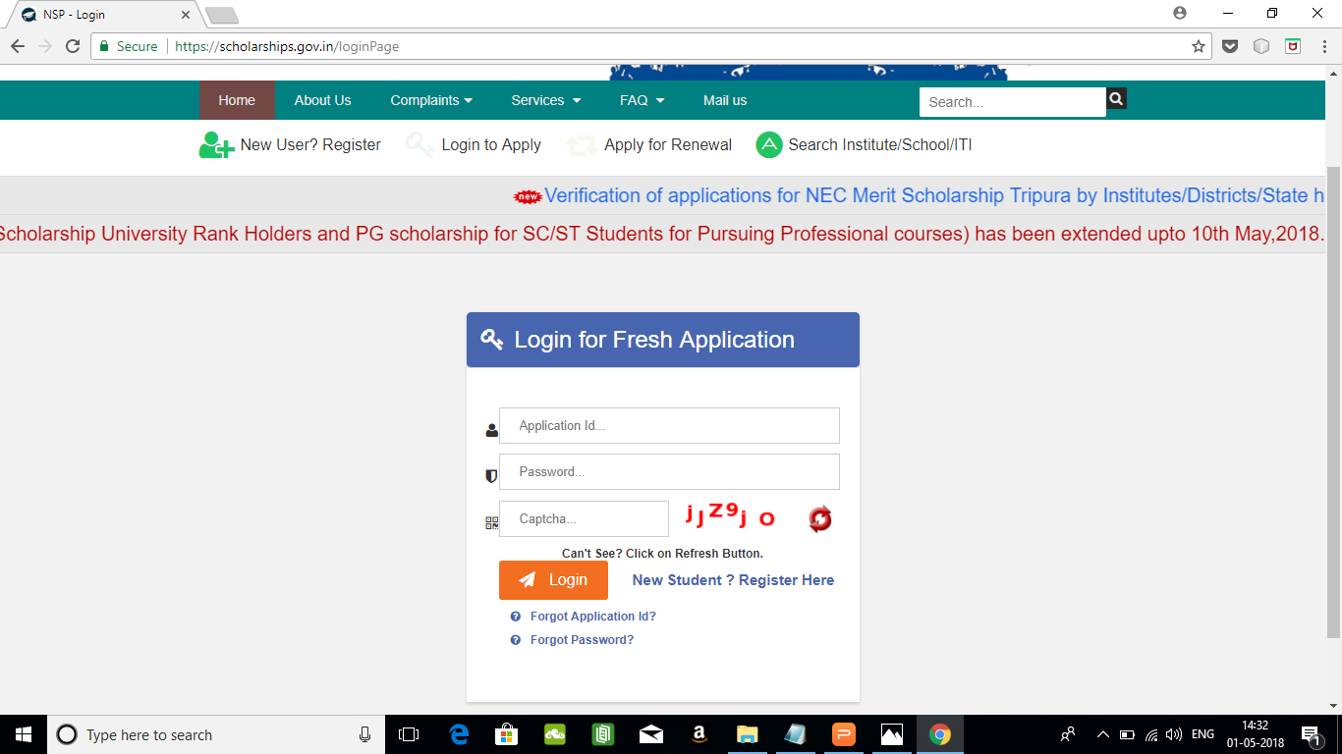
Enter the Password you received on your mobile number. After login for the first time, you will be directed to the change password page, where you have to change your password for future use.
Enter the Application Id and Passsword that you received on your Mobile No.
Select this link if you have not registered earlier and do not have a valid application id
If you forgot your password, you can use this option to regenerate a new password.
Click this link if you forgot your application id

Slide 12
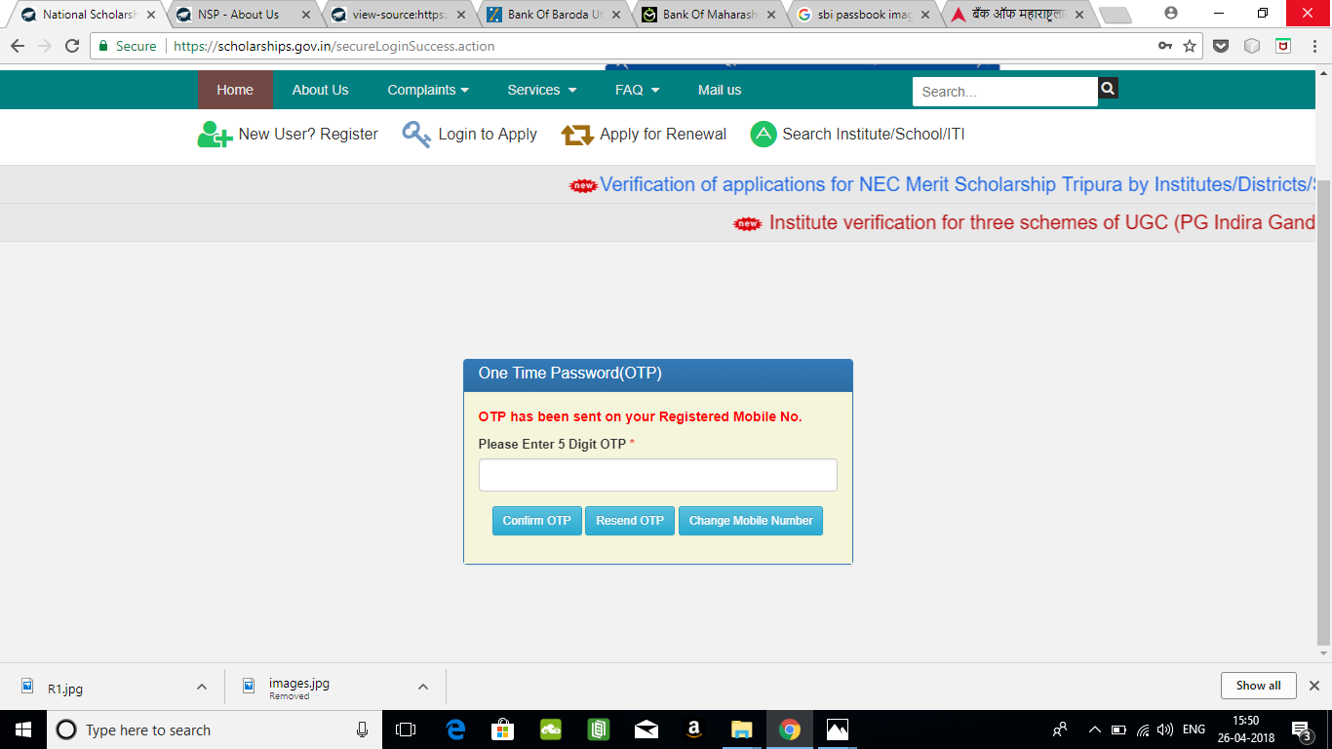
On successful login, an OTP is sent to your mobile number before password reset. Upon entering the OTP, you will be redirected to the Password RESET Page.

Slide 13
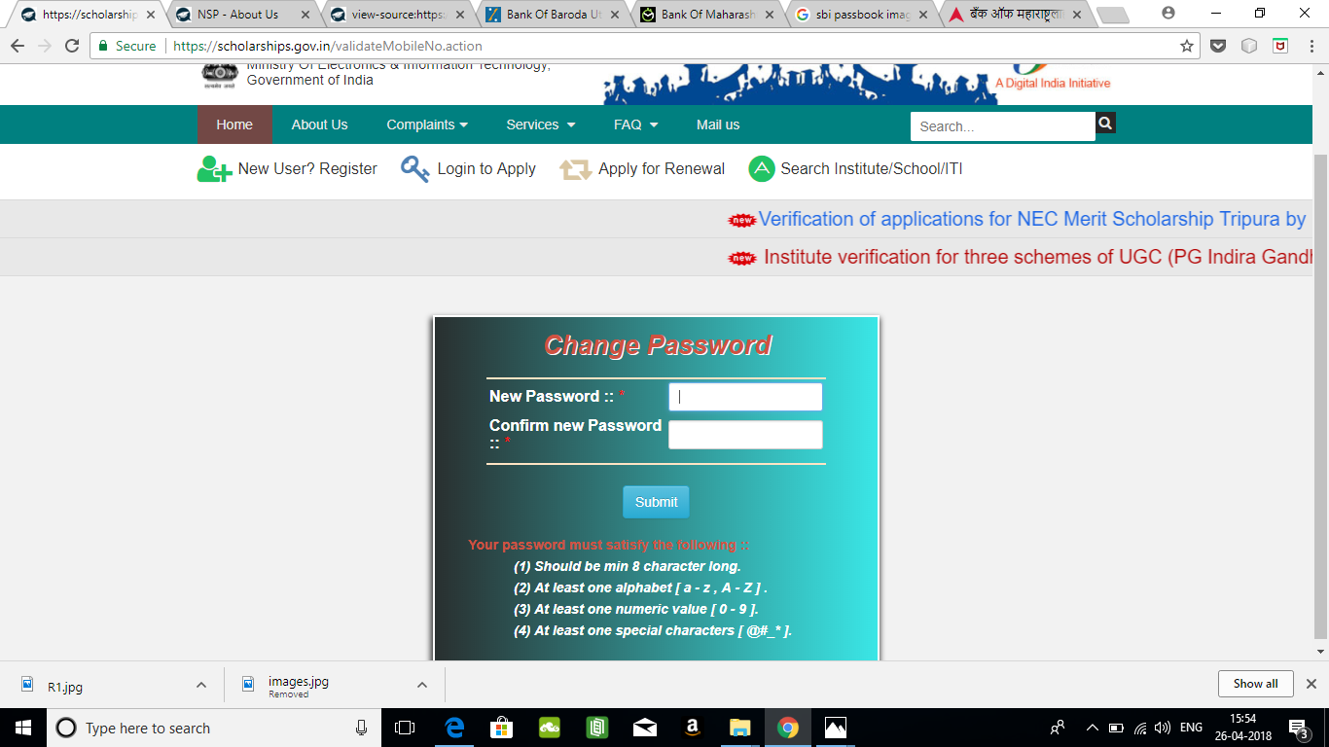
Screen to enter the new password. Rules of the new password is given below.

Slide 14
AFTER SUCCESFULL FRESH APPLICATION LOGIN
Upon successful registration, applicant is forced to change password if login is done for the first time. As the applicant logins an OTP is sent to his/her registered mobile number. After verifying the OTP, applicant is redirected to change Password page.
Once the student changes the password, they will be directed to the Applicant’s Dashboard page.

Slide 15
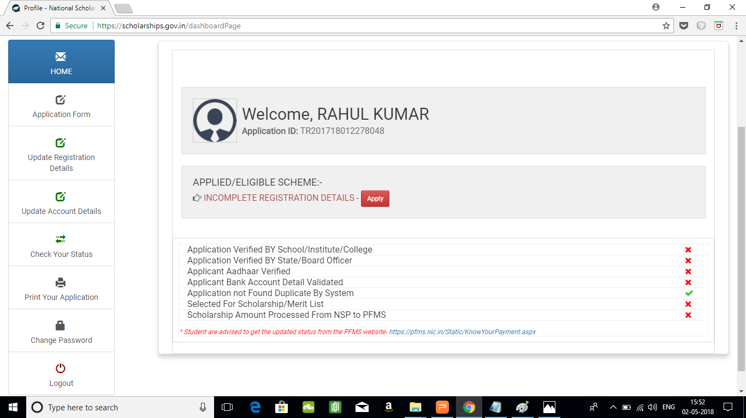
Click on Application Form

Slide 16
Application Form
Application Form is divided into three Parts:
Registration Details
Academic Details
Basic Details

Slide 17
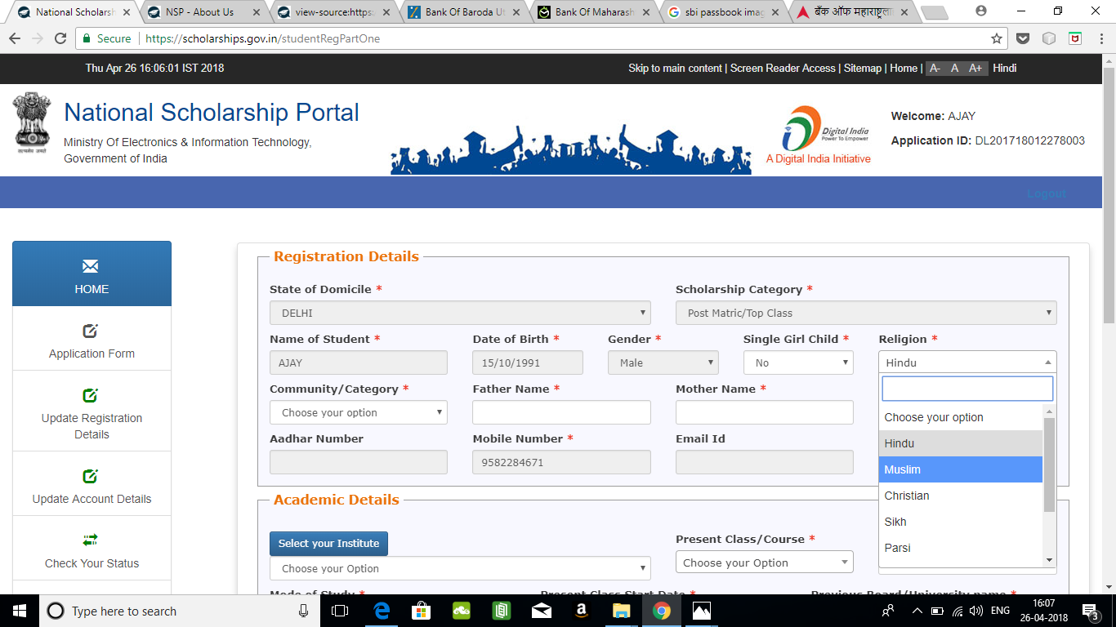
Dropdown list of Religion

Slide 18
Registraion Page Section
You can select the relevant Community like SC/ST/OBC/GENERAL etc from this drop down list
This column is for schemes for those girls who are single girl child of their parents
Data entered at the time of registration is automatically filled and is not editable
This drop down contains the various religions for applications to schemes of Minority

Slide 19
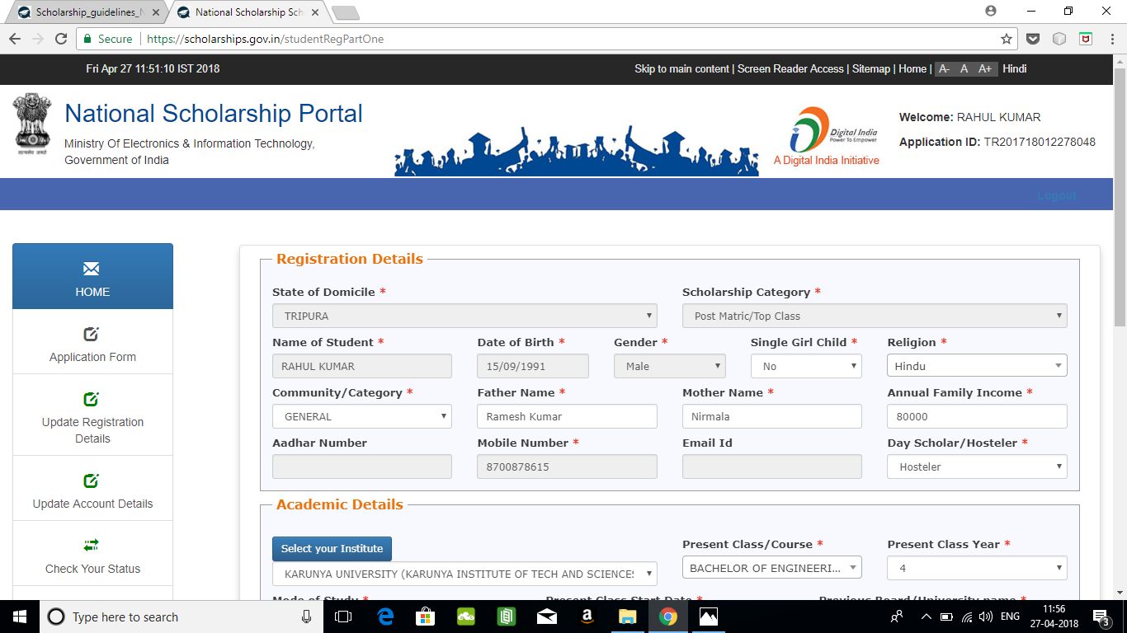
Select whether you are a day scholar or Hosteller from this drop down

Slide 20
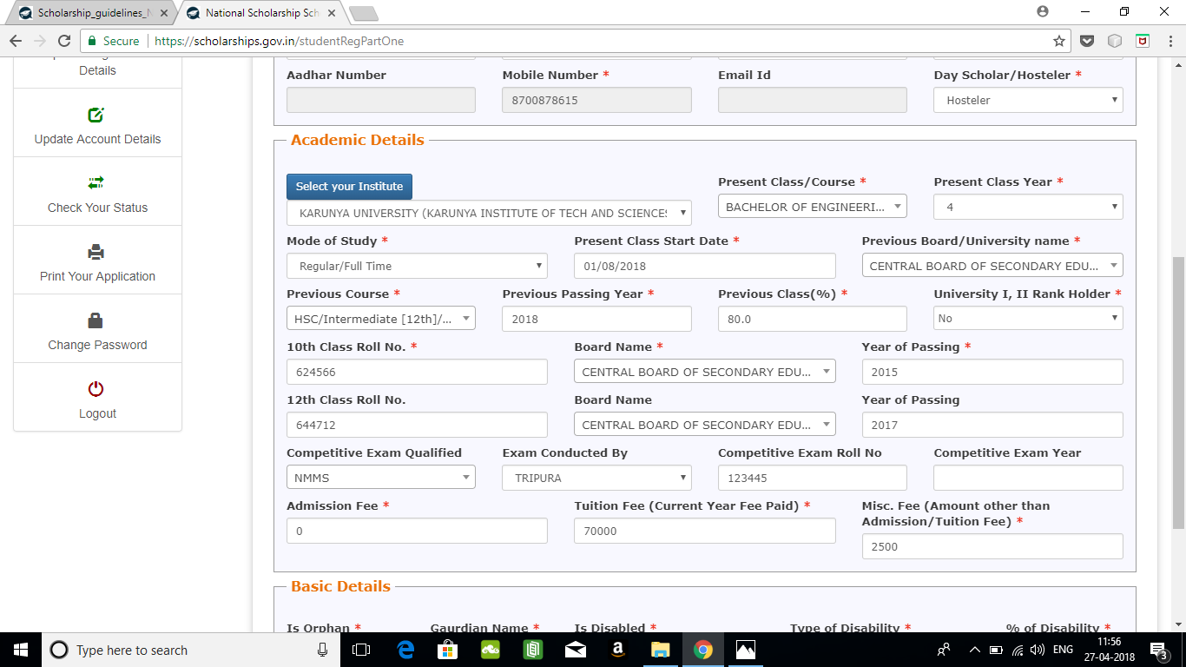
ACADEMIC DETAIL SECTION

Slide 21
Click on this button for selecting institute
For refreshing the course list, please select the institute again using select your institute button

Slide 22
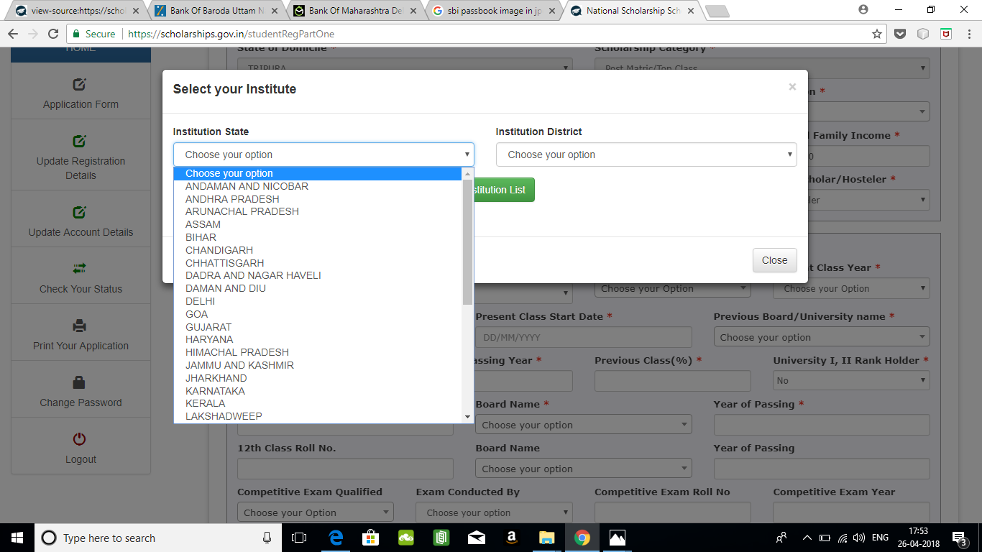
First select the state in which the institute is located, then select the district . If you know the AISHE/DISE /NCVT code of the institute, you can search the institute using that also in the search buttton

Slide 23
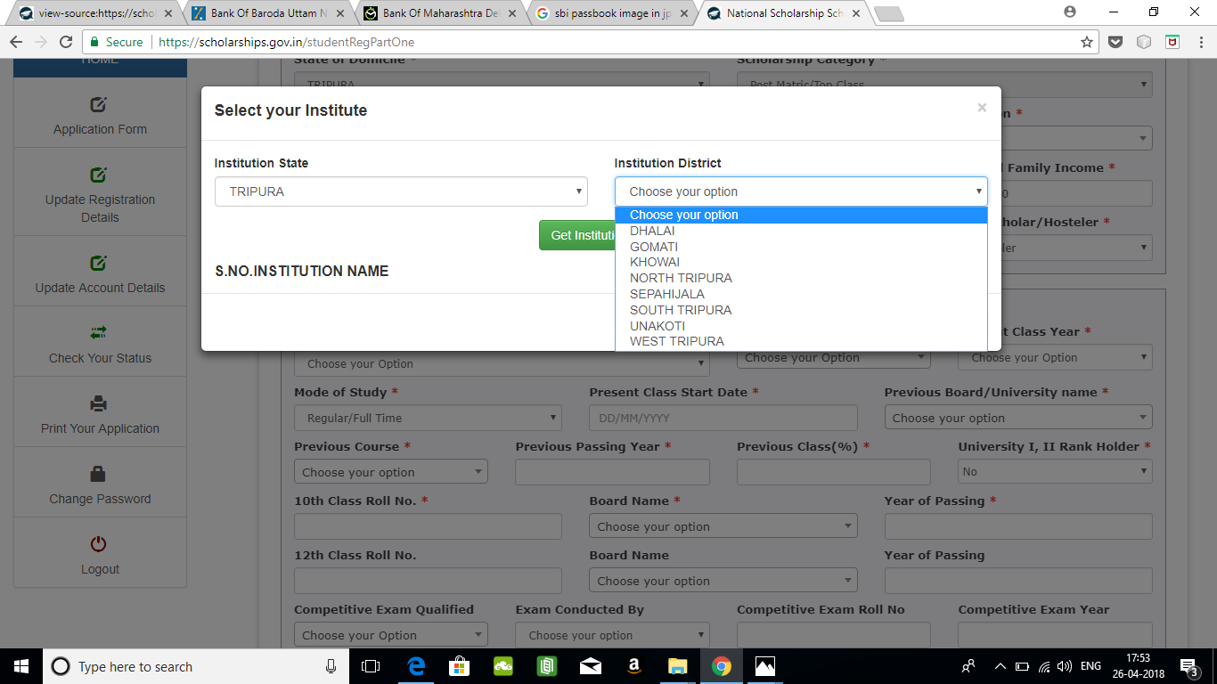
Upon selecting the district, all the institutes in that state/district will appear. You can select your institute from there.

Slide 24
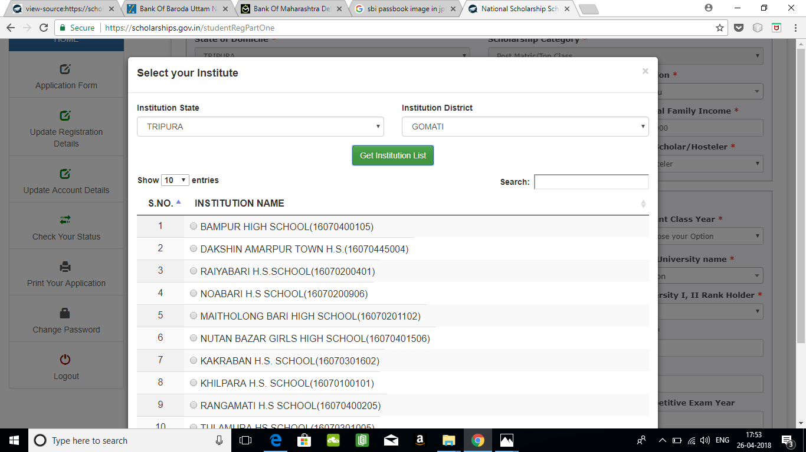
After Filling Institute State and Institute District... Click Get Institution List You will get All Institution Name accoding to your selected data.

Slide 25
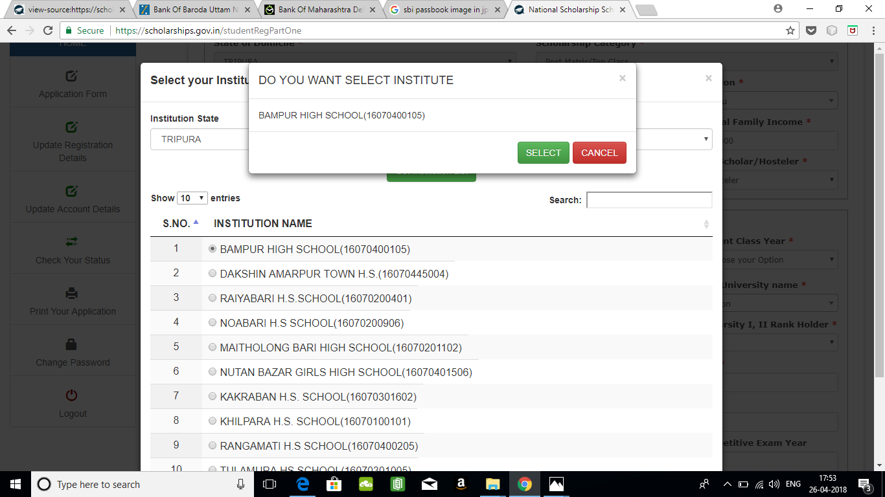
The selected Institution Name will be displayed in a popup message. Click on the select button if the name of the institute is correct or cancel if you want to reselect the institute again.

Slide 26
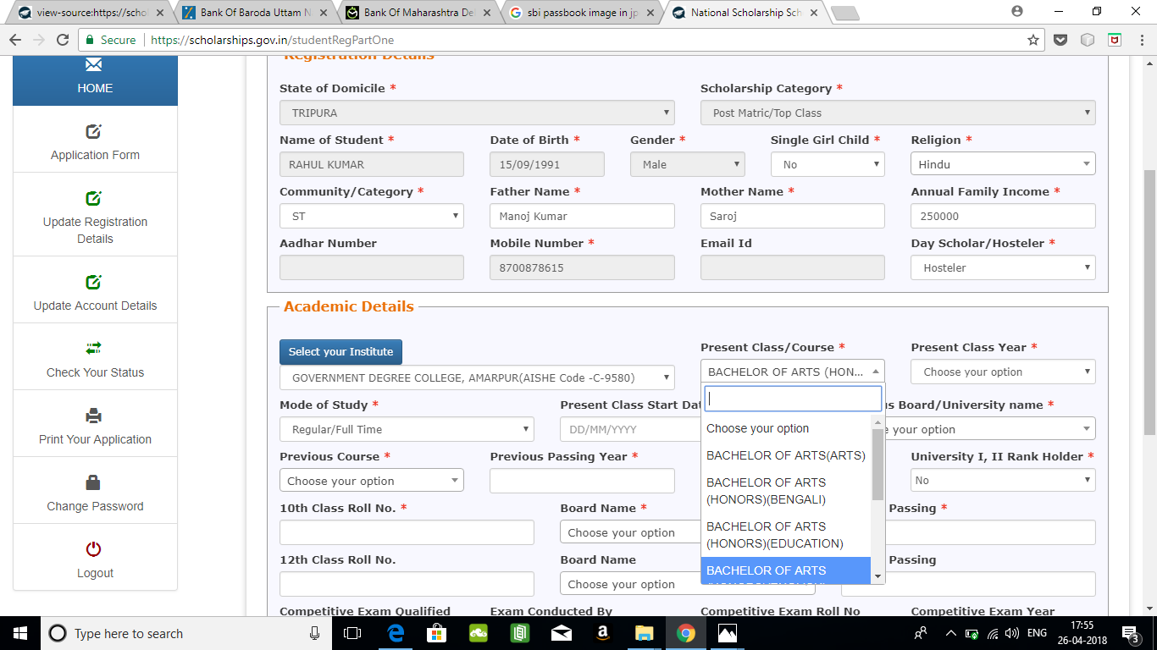
According to the chosen institute, courses will be displayed here.

Slide 27
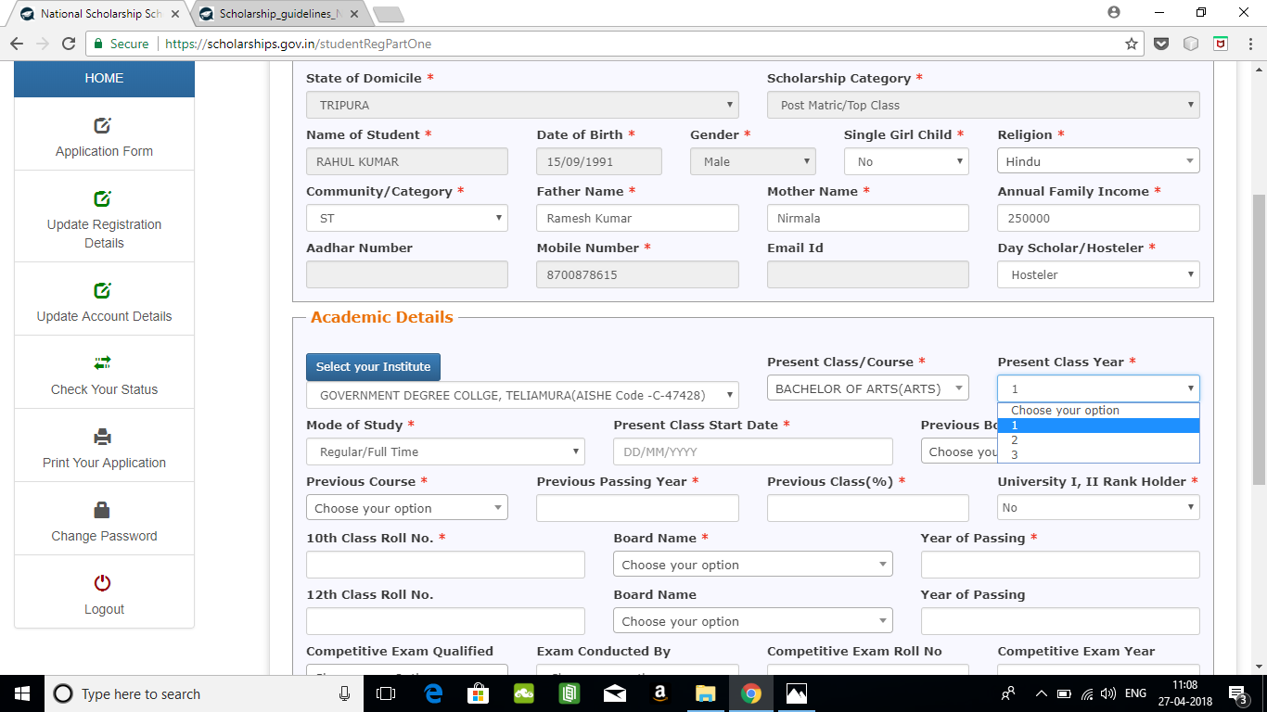
Please select the course year in which you are studying

Slide 28
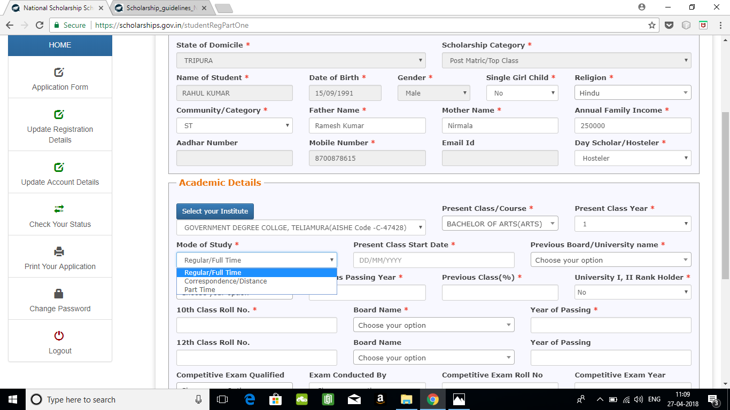
Select whether correspondence or regular study mode

Slide 29
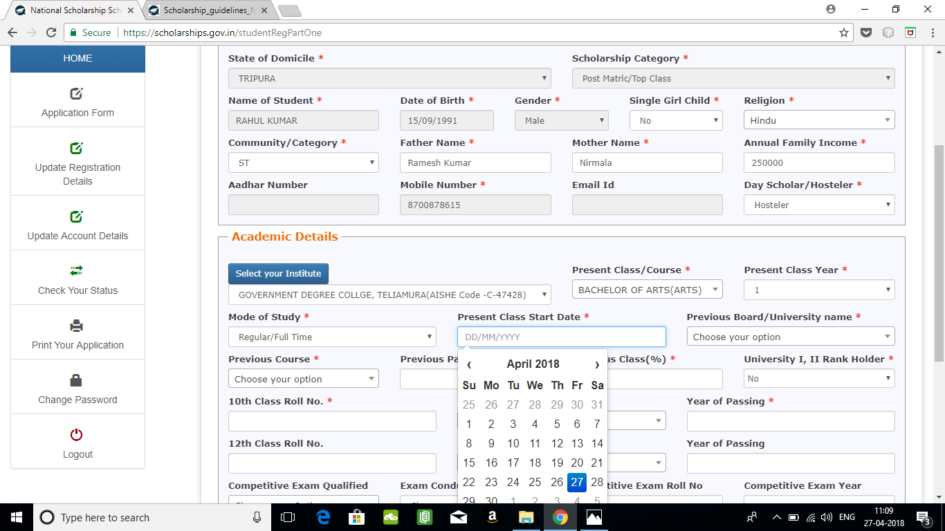
Select the current class start date from the calendar

Slide 30
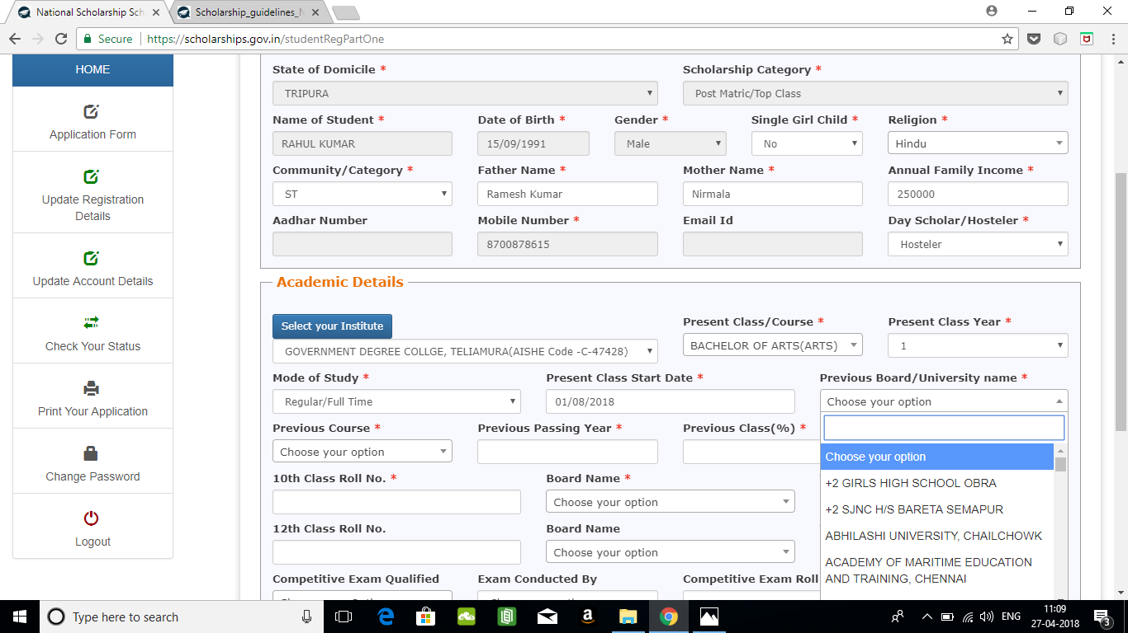
Select your Board/University

Slide 31
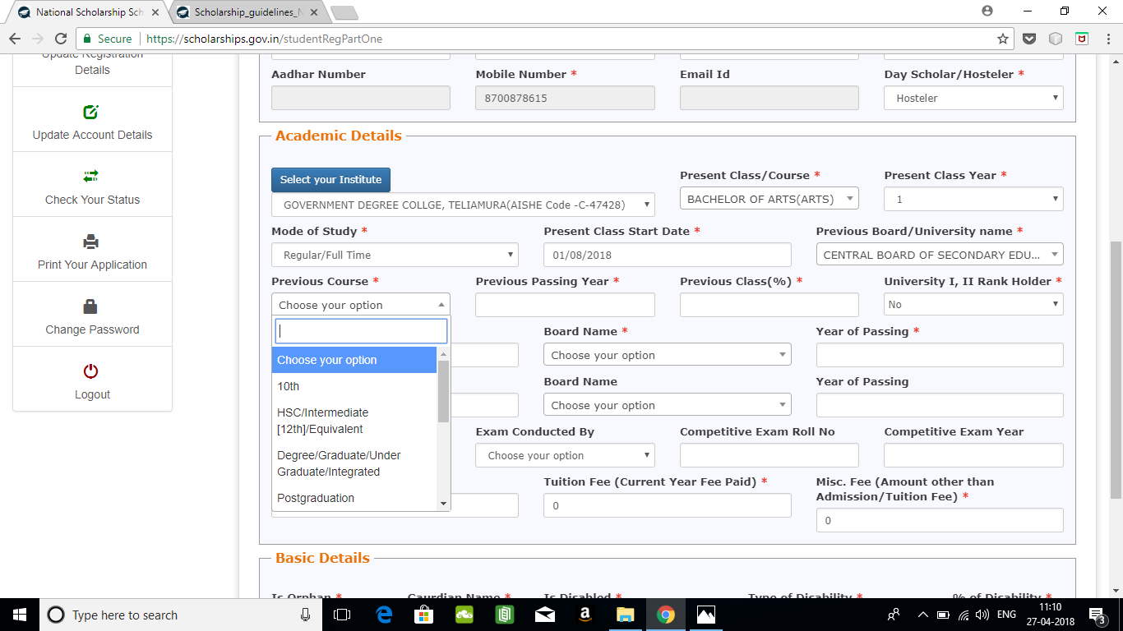
Dopdownlist of Previous Course

Slide 32
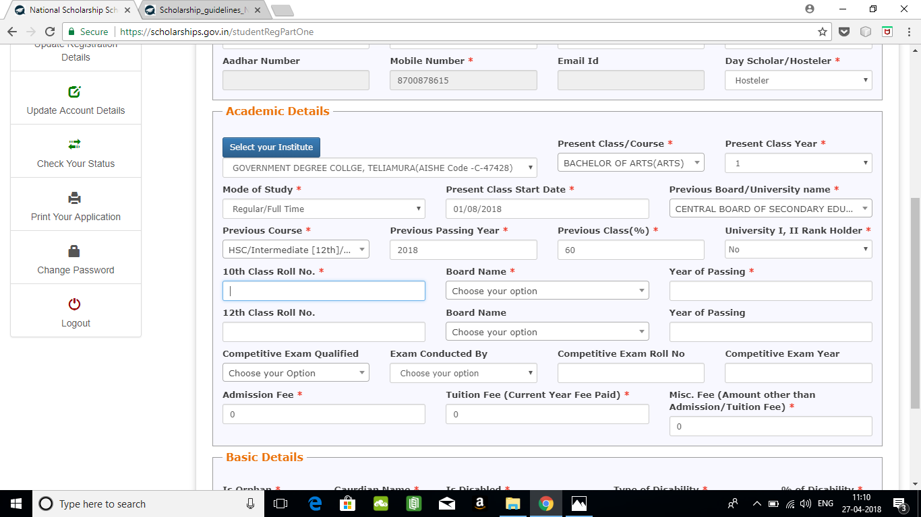
All fields marked with a red * are mandatory

Slide 33
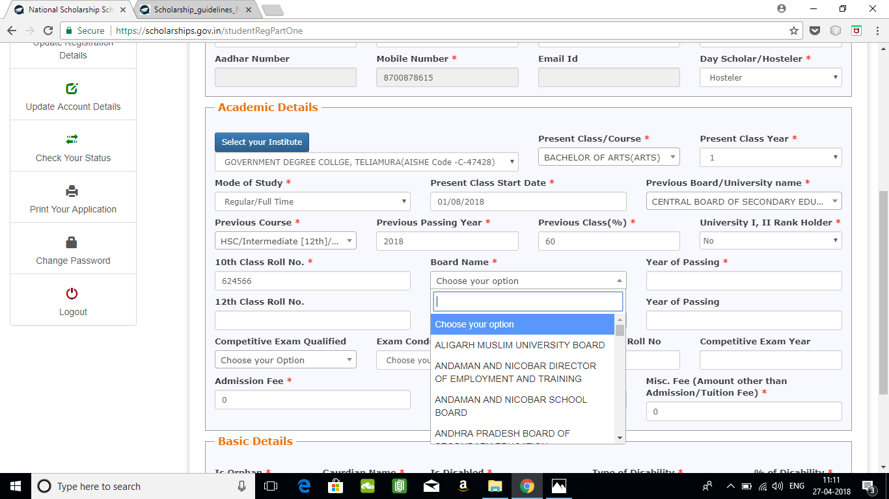
Select class 10 board

Slide 34
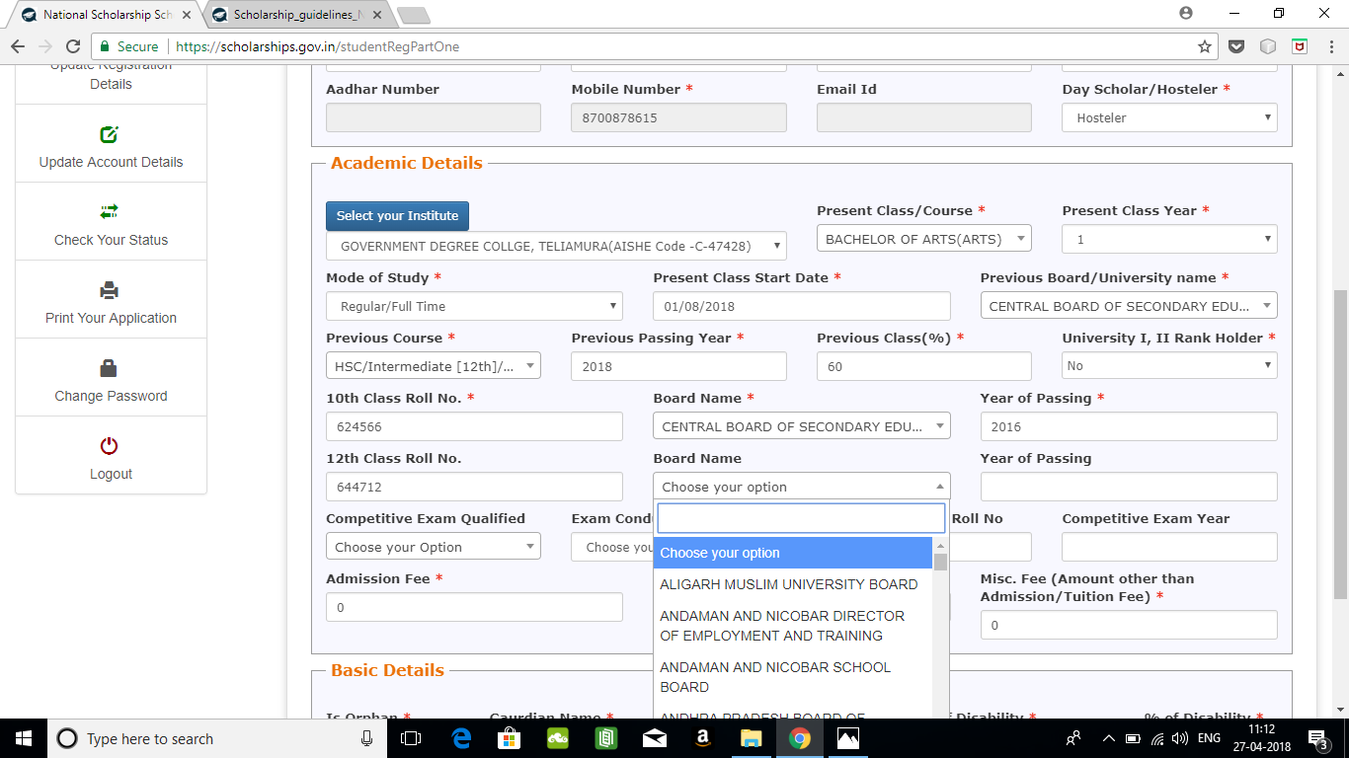
Select class12 board

Slide 35
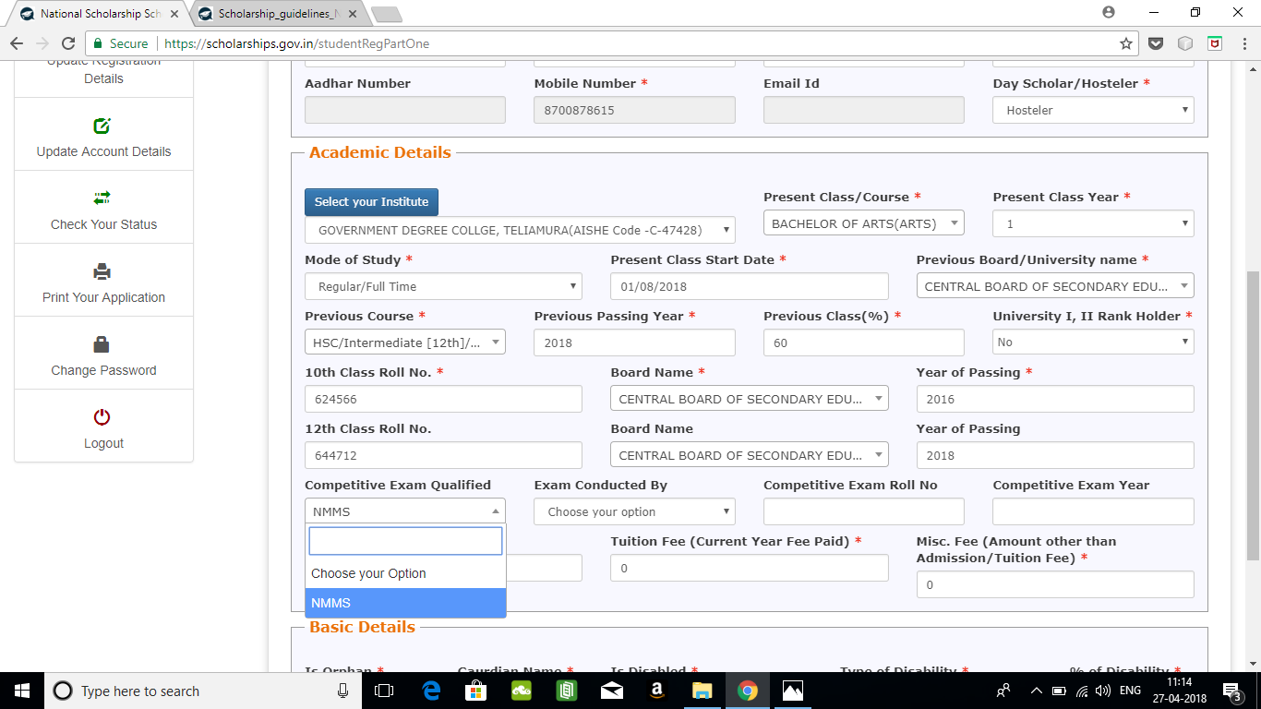
Select competitive exam qualified. Applicable only for NMMS Scheme

Slide 36
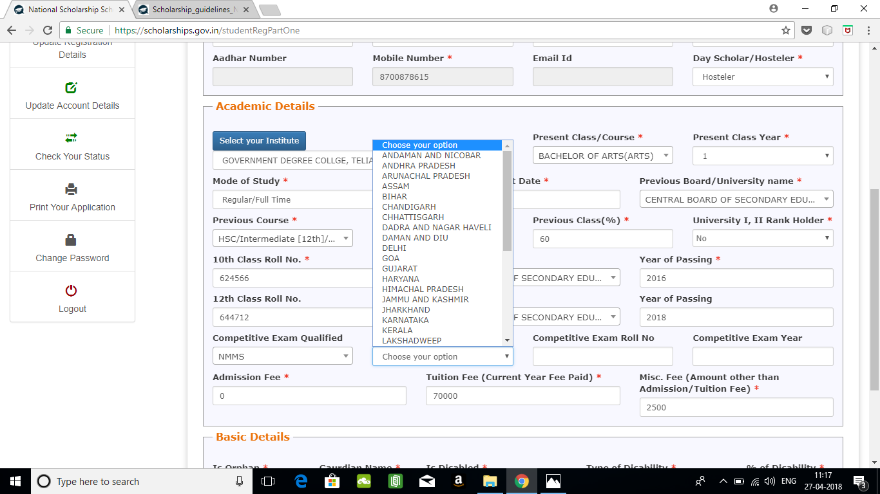
Select state name

Slide 37
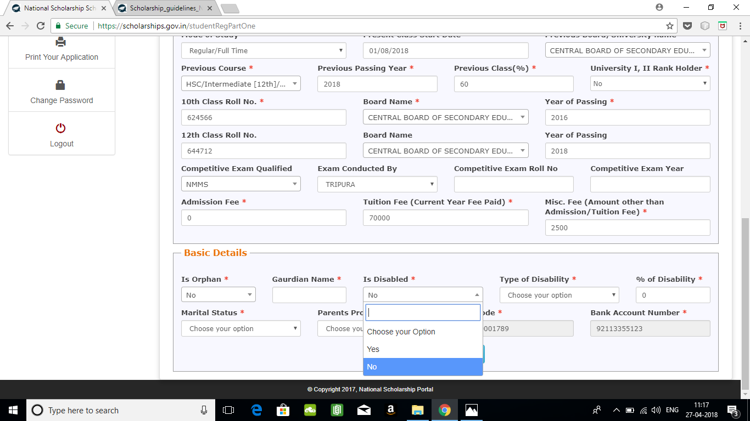
BASIC DETAILS SECTION
Select yes if you are an orphan
Select yes if you are disabled

Slide 38
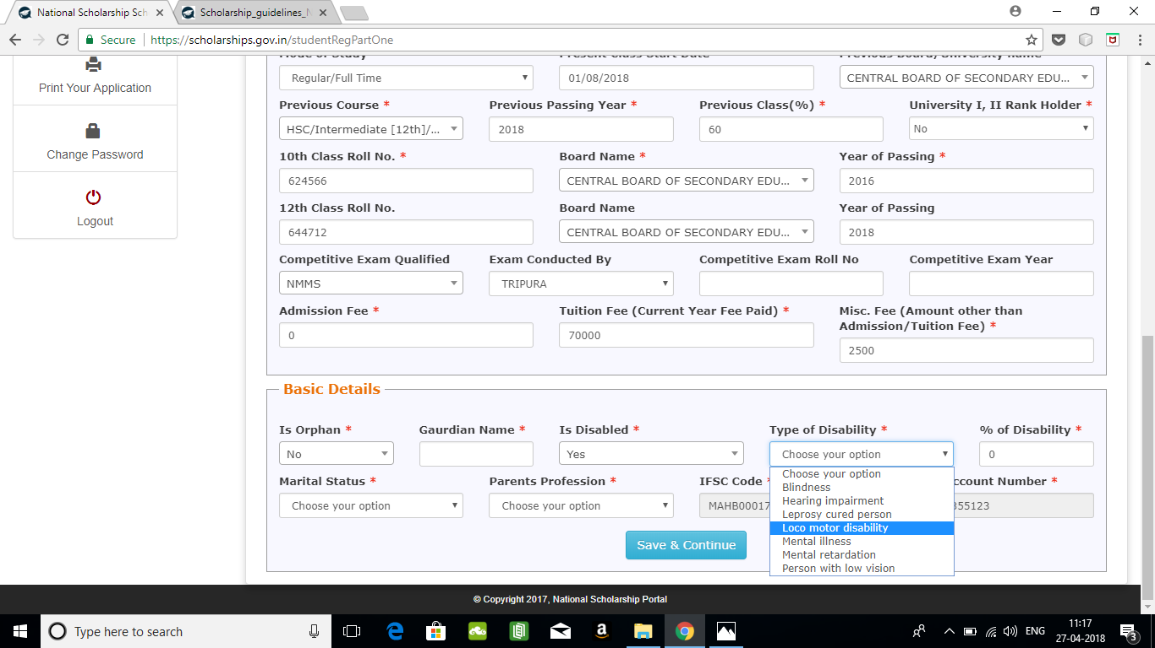
Select type of disability

Slide 39
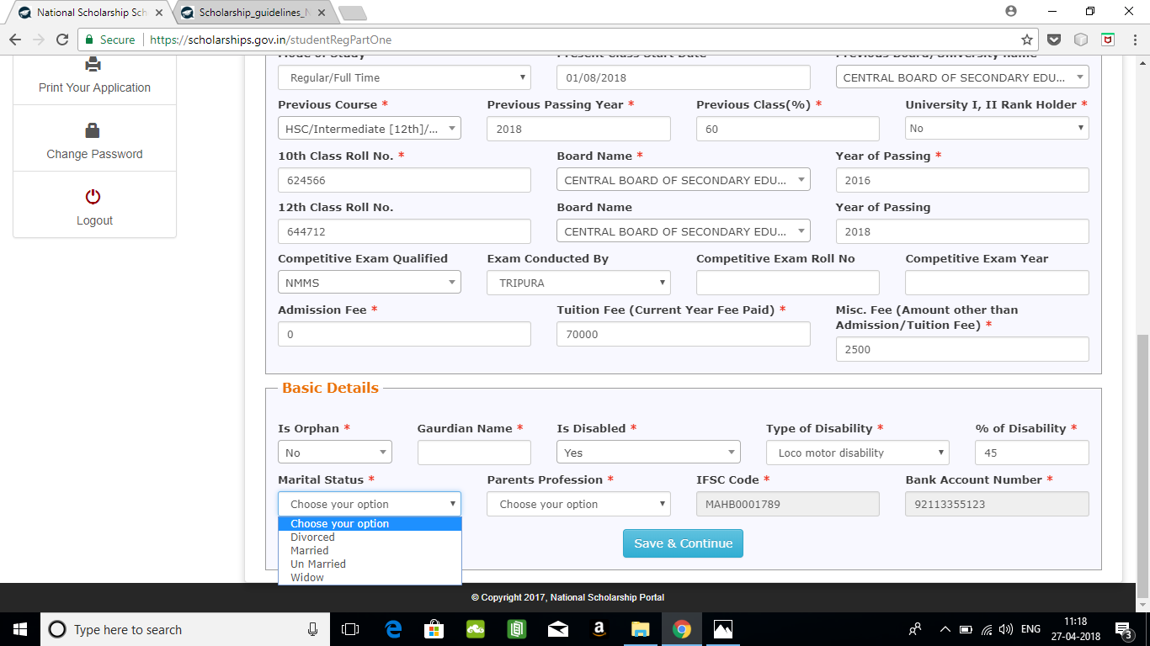
Select Married if you are married

Slide 40
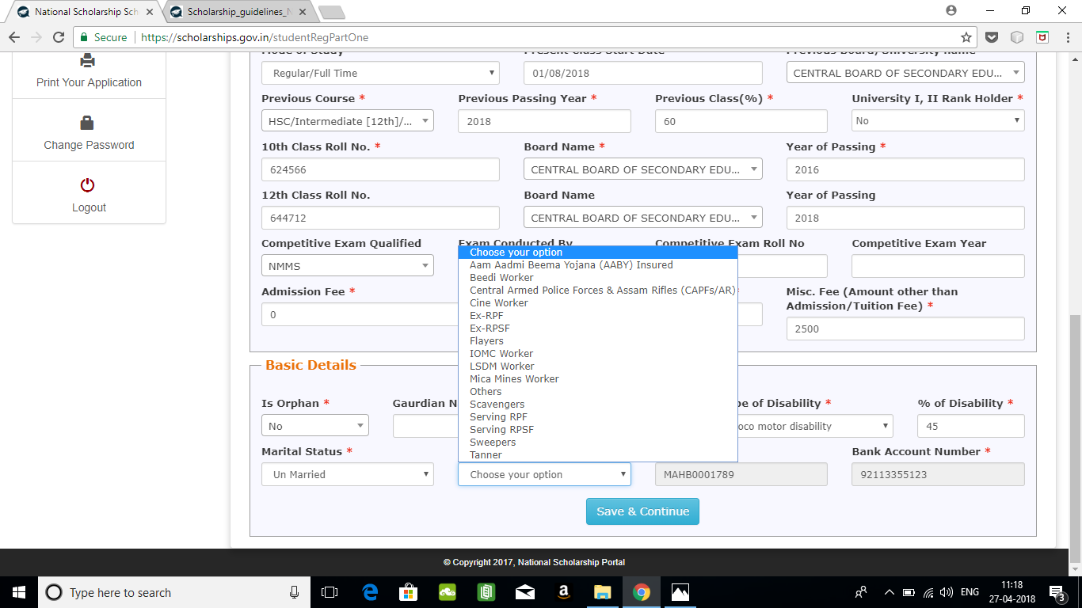
Select your parent’s profession. If not applicable, select others.

Slide 41
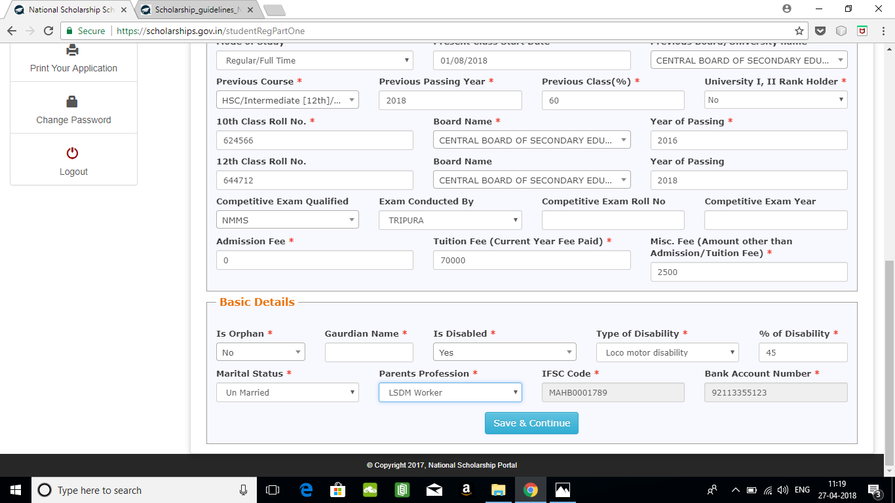
After filling all the mandatory fields, click on Save and continue to select scheme

Slide 42
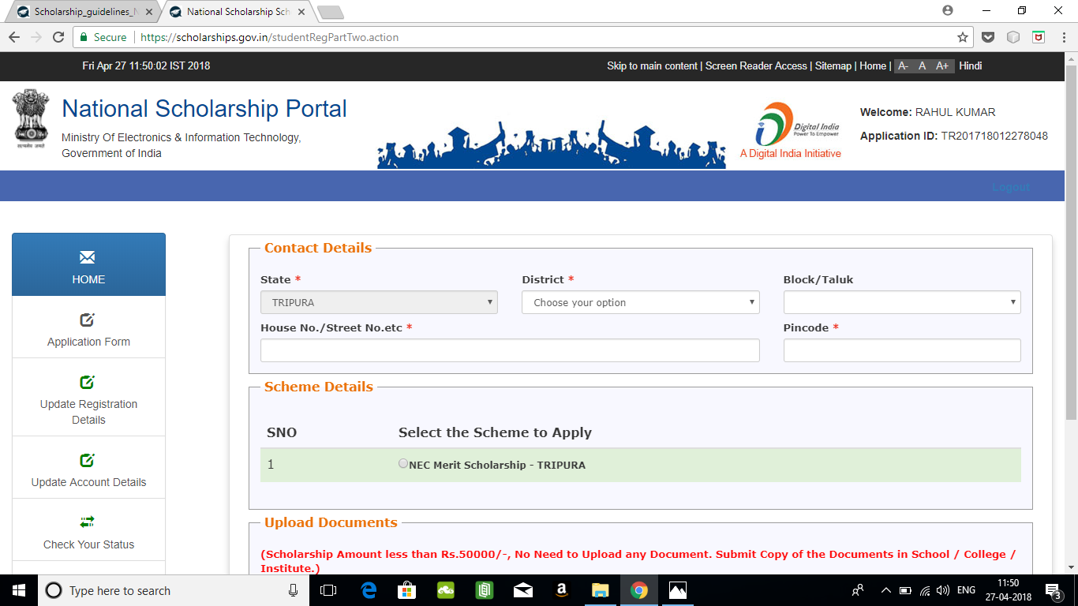
The eligible schemes based on entered criteria is displayed here

Slide 43
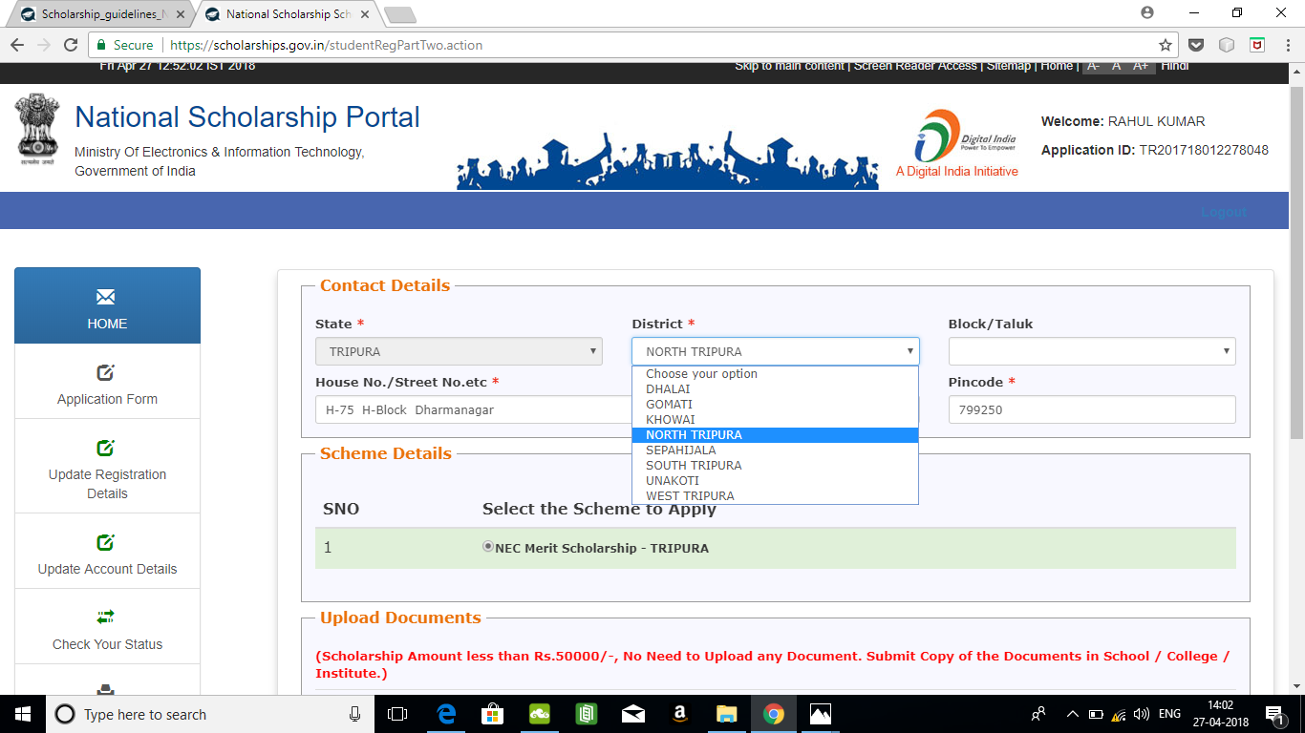
Domicile state as registered will be automatically displayed.
Districts of the selected State will be displayed here. Select your domicile district.

Slide 44
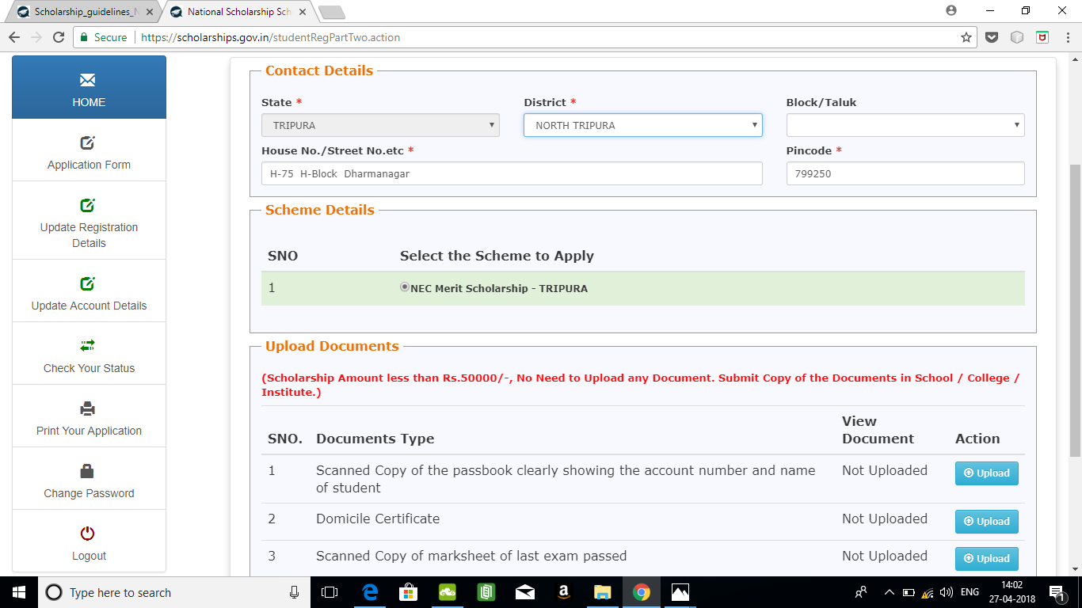
Select the scheme you want to apply. If total scholarship amount in that scheme is less than Rs.50000, there is no need to upload documents. But it is always better to upload documents to support for easier verification. Simply submit document with application copy at school/college/Institute

Slide 45
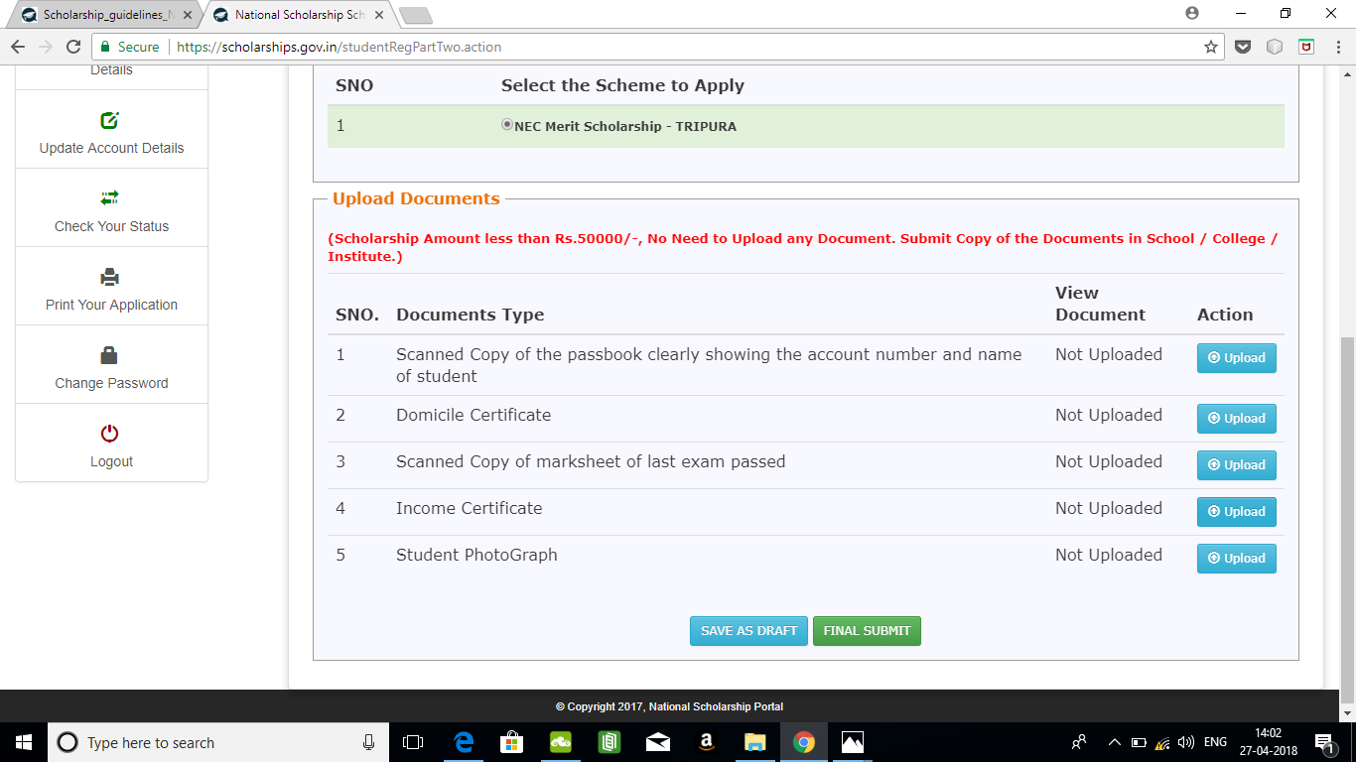
Please click on “Save as Draft” if you are not clear about any detail entered and you want to edit the form again.
If you are sure of the details entered, click on “Final Submit” to submit the form. Upon final submit, you will not be able to edit the form again.

Slide 46
FRESH APPLICATION LOGIN DASHBOARD
Use “Update Account Details” for changing account details. Final submitted applications cannot be changed.
For changing any registration details entered, use “update Registration Details”. Again, final submitted applications cannot be edited.
Logout Button

Slide 47
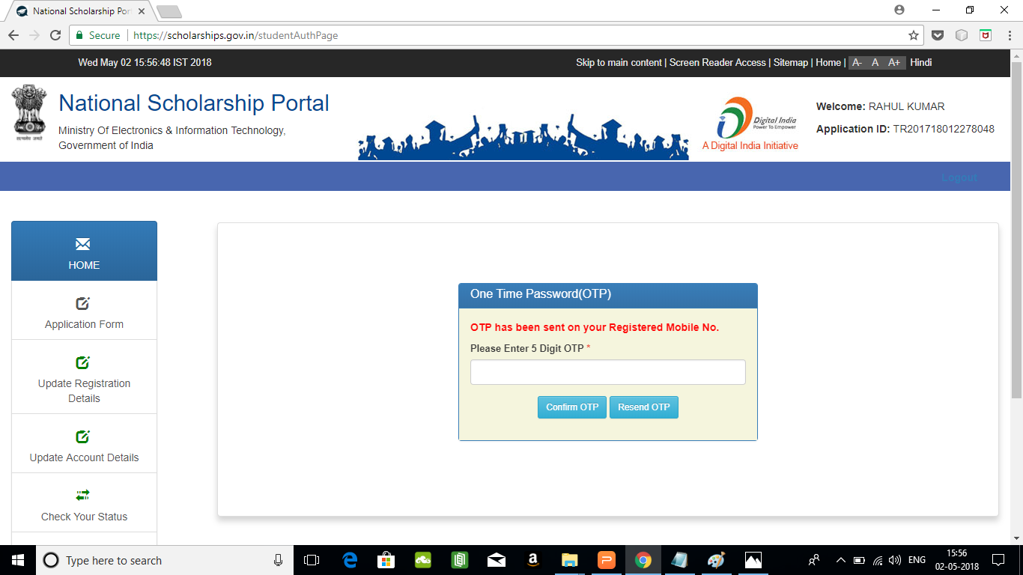
UPDATE REGISTRATION DETAILS
On clicking on “Update Registration Details” the student will receive an OTP in the registered mobile number. Enter the OTP to proceed to update registration details

Slide 48

UPDATE ACCOUNT DETAILS
On clicking on “Update Account Details” the student will receive an OTP in the registered mobile number. Enter the OTP to proceed to update account details

Slide 49
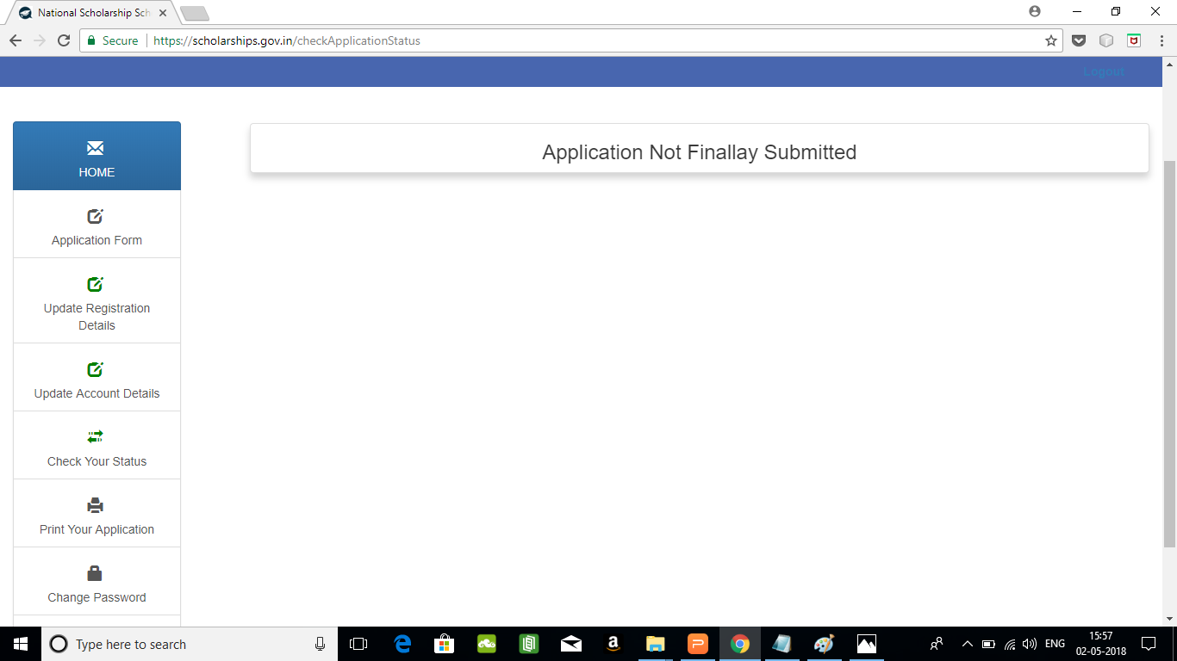
CHECK YOUR STATUS
“Check your Status” displays the current status of your application form

Slide 50
CHANGE PASSWORD
Use the “Change Password” link to change your existing password

Slide 51
CHANGE PASSWORD
Use the “Print Your Application” link to print final submitted applications

Slide 52
Logout Button

